Slide 1


Chaitanya Ashok Malagikar
09/04/2025

Slide 2

Outline
Executive Summary
Introduction
Methodology
Results
Conclusion
Appendix

Slide 3
Executive Summary
This project explores the analysis of SpaceX’s Falcon9 launch vehicle to understand mission trends, assess success rates, and derive actionable insights from data.
The methodology involves data collection, cleaning, visualization, and predictive modeling to deliver a comprehensive understanding of launch outcomes.

Slide 4
Introduction
SpaceX, a leader in aerospace innovation, conducts numerous launches aimed at advancing space exploration and commercial satellite deployment. This project leverages SpaceX's publicly available data to analyze launch trends, mission outcomes, and operational efficiency.
Problems you want to find answers:
Which launch sites have the highest number of launches and success rates?
How does payload mass affect the success of a launch in various orbit types
What trends can be observed in launch success over the years?
Which factors, such as flight numbers, orbit types, or payload sizes, influence mission outcomes?
How can predictive models be utilized to forecast launch success effectively?

Slide 5

Section 1

Slide 6
Methodology
Executive Summary
Data collection methodology:
Data has been collected using SpaceX’s API and through web scraping
Perform data wrangling
Handle missing values and create a binary numerical column to represent launch outcomes, indicating success or failure
Perform exploratory data analysis (EDA) using visualization and SQL
Perform interactive visual analytics using Folium and Plotly Dash
Perform predictive analysis using classification models
Classification models were built to predict launch outcomes, with hyperparameters tuned using Grid Search and cross-validation, and performance evaluated through metrics like accuracy

Slide 7
Data Collection
The data was collected by using the SpaceX API and through web scraping.
The details of the data collection process is explained further in the following slides.

Slide 8
Data Collection – SpaceX API
The data for this analysis was obtained using the SpaceX API, with the process detailed in the accompanying flowchart
The code for the project is given Here
Get JSON content using GET request
Parse through the data to get important features
Filter the dataset to include only Falcon9 launches
Replace missing values with mean of the column

Slide 9
Data Collection - Scraping
Data has been collected from a Wikipedia page containing details of Falcon9 launch vehicle. The process is detailed in the accompanying flowchart
The code for the project is given Here
Get Data of Falcon9 wiki page using GET Method
Extract Column names of the HTML table containing Falcon9 Data
Create dataset by parsing through table
Adding data frame columns to the dataset created through API

Slide 10
Data Wrangling
To gain meaningful insights into the dataset, an analysis was conducted to examine the number of launches at each site, the frequency of occurrences for different orbit types, and the distribution of various landing outcomes. This study provided valuable trends and patterns across key columns.
The key task performed here was the addition of a class column to the dataset, which represents a binary classification indicating whether a launch was successful. The steps to accomplish this are outlined below:
The code for the project is given Here
Load Dataset
Enumerate through ‘Landing Outcome’ Column
Create 2 Outcomes ‘Good’ and ‘Bad’ based on values
Create Class List based on Outcome
Add Class to the dataset

Slide 11
EDA with Data Visualization
Flight Number vs. Launch Site: Plot to check which launch sites were associated with different flight numbers and their corresponding success rates.
Payload Mass vs. Launch Site: To investigate the relationship between payload mass and the launch site. Highlighted that rockets launched from the VAFB-SLC site did not carry heavy payloads
Success Rate vs. Orbit Type: To evaluate the success rate of missions for each orbit type. Orbits like GEO, LEO and SSO have high success rate which SO has no successful missions.
Flight Number vs. Orbit Type: To explore the connection between flight numbers and orbit types. Success seems to be related to the number of flights in LEO but in the GTO orbit, there appears to be no relationship between flight number and success.

Slide 12
EDA with Data Visualization
Payload Mass vs. Orbit Type: To uncover the relationship between payload mass and orbit types. The heaviest payloads are placed in the VLEO orbit. GTO success reduces as the payload increases
Launch Site vs. Orbit Type: To investigate the relationship between launch site and orbit types. VAFB SLC 4E launch site is exclusively utilized for PO and SSO orbits, whereas the CCAFS SLC 40 launch site is versatile and supports nearly all orbit types
Launch Success Yearly Trend: To analyze the yearly trend in launch success rates. Success rates increased significantly from 2014 to 2020, reflecting improvements in rocket technology or launch strategies.
The code for the project is given Here

Slide 13
EDA with SQL
All the Launch Sites from the dataset found using distinct
Queried launch sites starting with CCA using Like and showed 5 records using limit
Calculated the total payload mass carried by boosters using sum()
Calculated the average payload for booster version F9v1.1 using avg()
Found the earliest date of successful landing on ground pad using min()
Listed booster versions that successfully landed on drone ship with payload mass between 4000 and 6000 kgs

Slide 14
EDA with SQL
7. Counted total number of success and failures with count() and grouped them
8. Retrieved booster version that carried maximum payload mass using max()
9. Displayed how substr() is used by showing failed drone ship landings in 2015
10. Counted landing outcomes between specified dates with count() and grouped them
The code for this project is given Here

Slide 15
Build an Interactive Map with Folium
Launch Site Locations: The first interactive map uses circles to highlight the geographical locations of the launch sites. Each circle is paired with a marker to display the name of the respective site.
Launch Outcomes: The second map utilizes a marker cluster to effectively visualize the number of successful and unsuccessful launches at each site. This feature makes it easier to analyze launch performance at a glance.
Proximity to Key Features: The third map explores the proximity of each launch site to critical infrastructure and natural features, such as highways, coastlines, and nearby cities.
The code for this project is given Here

Slide 16
Build a Dashboard with Plotly Dash
Dropdown menu provides an interactive way to filter the data by launch site. It enables the user to focus on a particular site or aggregated data across all sites
Pie Chart visualizes the total number of successful launches of all sites. If a particular site is selected, it gives insight of its success and failures
The range slider is given to filter the data based on payload mass which allows user to gain better insights on correlation between payload mass and launch success
Provides a scatter plot of launch success and payload mass which provides a way to study the impact of payload mass on successful launch. Includes color coded markers of different booster versions for additional detail
The code for this project is given Here

Slide 17
Predictive Analysis (Classification)
Developed a model to predict whether a rocket successfully lands or fails, based on key input features
Applied multiple classification techniques including Logistic Regression, SVM, Decision Tree and KNN. The workflow is as follows:-
We got the best training accuracy with the Decision Tree method. The results are given in the following section.
The code for this project is given Here
Define Parameters
Classification Method
Grid Search
Fit Model
Retrieve Best Parameters

Slide 18
Results
Exploratory data analysis results has been shown using both the plots and queries to explain the data present in the dataset
Interactive analytics demo in screenshots. Here the screenshots of both the folium maps and the dash app has been shown
Predictive analysis results where the accuracy of the findings and the confusion matrix has been displayed

Slide 19

Section 2

Slide 20
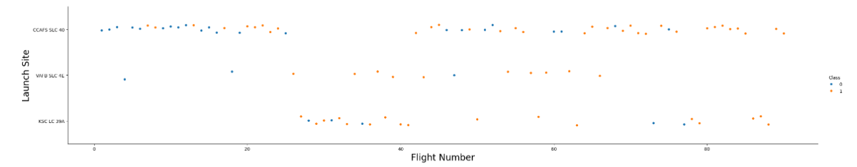
Flight Number vs. Launch Site
There are 3 Launch Sites and the Flight Number of the launches have been plotted.
The Class represents the number of successful and unsuccessful launches with 1 and 0 respectively.

Slide 21
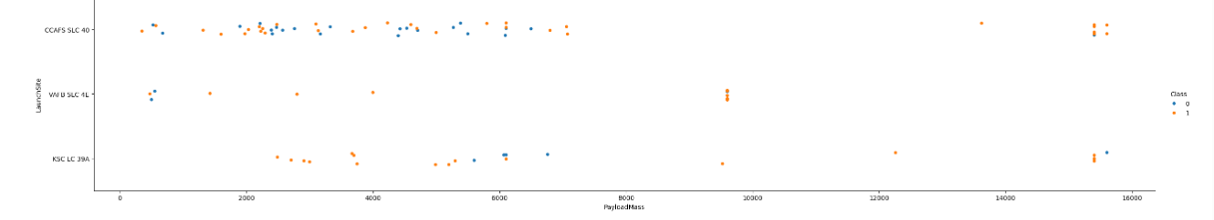
Payload vs. Launch Site
There are 3 Launch Sites and the Payload Mass of the launches have been plotted.
The Class represents the number of successful and unsuccessful launches with 1 and 0 respectively.

Slide 22
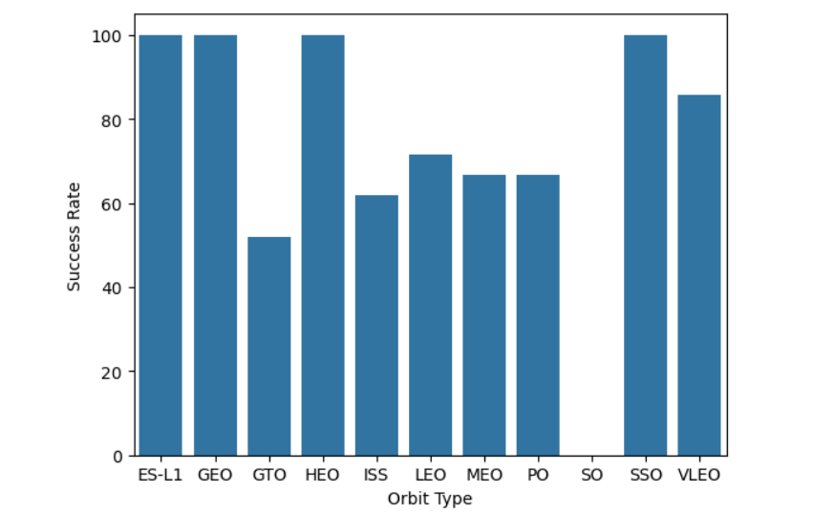
Success Rate vs. Orbit Type
The bar chart represents the Success rate of the launches with respect to the orbit type.
From the plot we can gather important information like the SO orbit having no successful launches and orbits like GEO and HEO having 100% success

Slide 23
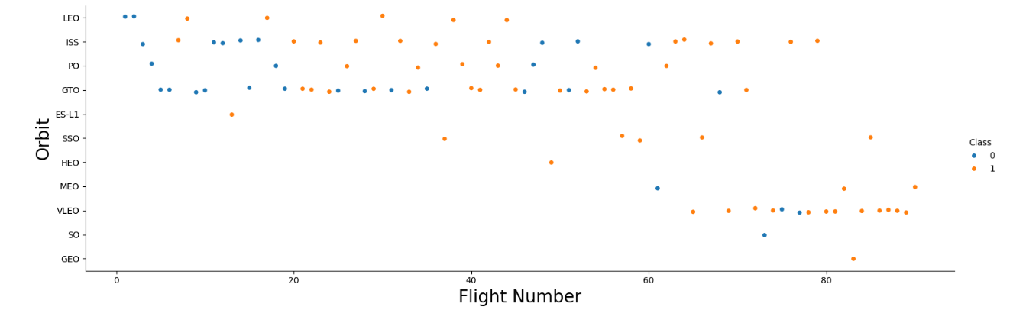
Flight Number vs. Orbit Type
The various orbits where the satellites were launched and the flight number of the launches have been plotted.
The Class represents the number of successful and unsuccessful launches with 1 and 0 respectively.

Slide 24
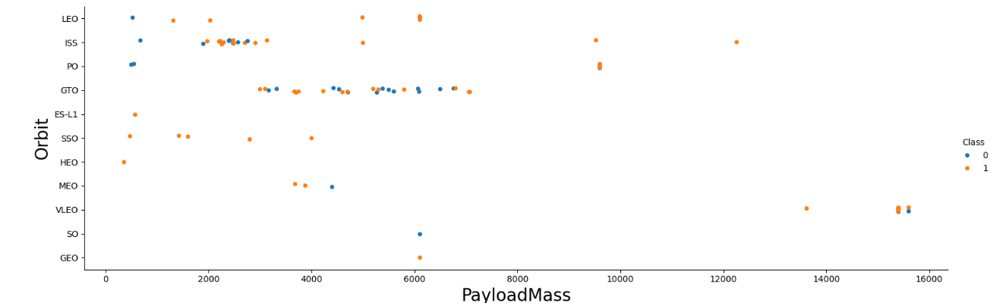
Payload vs. Orbit Type
The various orbits where the satellites were launched and the Payload Mass of the launches have been plotted.
The Class represents the number of successful and unsuccessful launches with 1 and 0 respectively.

Slide 25
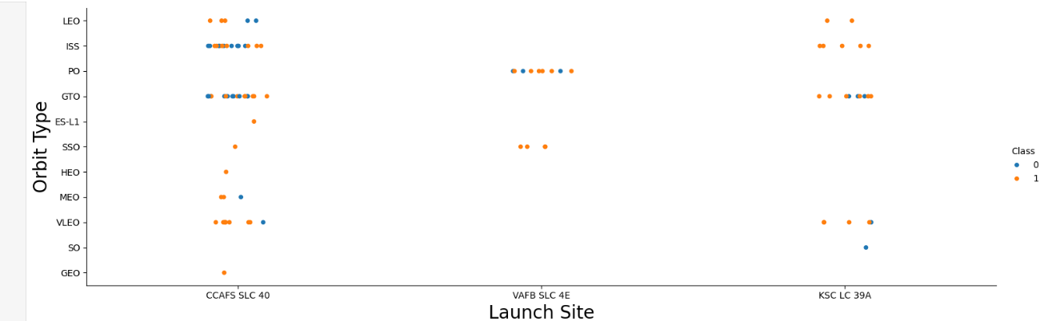
Launch Site vs. Orbit Type
The plot illustrates that the VAFB SLC 4E launch site is exclusively utilized for PO and SSO orbits, whereas the CCAFS SLC 40 launch site is versatile and supports nearly all orbit types.
The Class represents the number of successful and unsuccessful launches with 1 and 0 respectively.

Slide 26
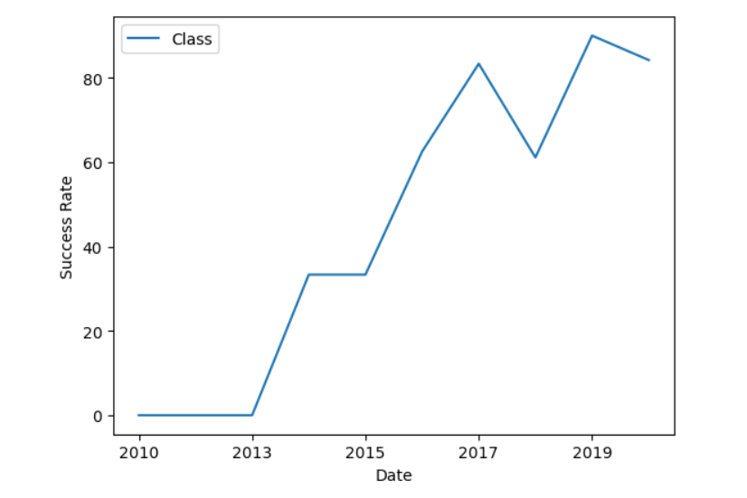
Launch Success Yearly Trend
The line plot shows the successful launches percentage as the years go by.
The number of successful launches has increased year on year except a blip in 2018.

Slide 27
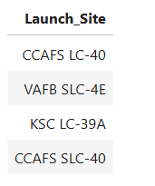
All Launch Site Names
%sql Select distinct Launch_Site from SPACEXTBL
There are 4 launch sites used in Space X for launching rockets. Distinct keyword used to extract the sites

Slide 28
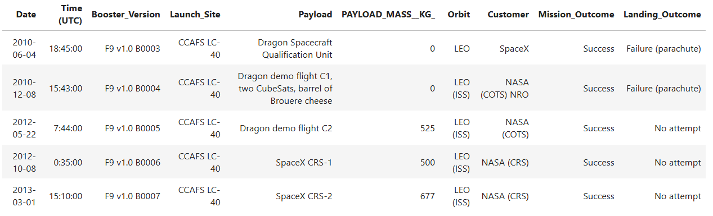
Launch Site Names Begin with 'CCA'
%sql Select * from SPACEXTBL where Launch_Site like 'CCA%' \limit 5
These are 5 records whose launch site starts with CCA. Limit used to see only 5 records

Slide 29
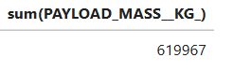
Total Payload Mass
%sql Select sum(PAYLOAD_MASS__KG_) from SPACEXTBL
The total payload mass is 619,967 kgs. Sum of all weights of the column has been using sum keyword

Slide 30
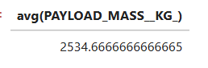
Average Payload Mass by F9 v1.1
%sql Select avg(PAYLOAD_MASS__KG_) from SPACEXTBL where Booster_Version like '%F9 v1.1%’
The average mass of payload for booster version F9 v1.1 is 2534.67kgs. Avg used to get average mass and like used to filter booster version

Slide 31
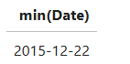
First Successful Ground Landing Date
%sql Select min(Date) from SPACEXTBL where Landing_Outcome = 'Success (ground pad)’
First Successful ground landing date was on 22/12/2015. min gives the earliest date and where used to filter the landing outcome

Slide 32
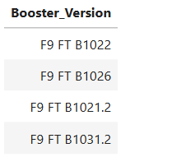
Successful Drone Ship Landing with Payload between 4000 and 6000
%sql Select Booster_Version from SPACEXTBL where Landing_Outcome = 'Success (drone ship)' and PAYLOAD_MASS__KG_ between 4000 and 6000
There are 4 booster versions where drone ship landing was successful between 4000 and 6000 kgs. Where and between used here for filtering

Slide 33
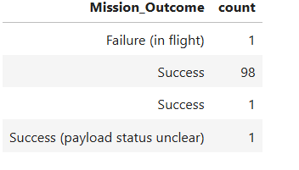
Total Number of Successful and Failure Mission Outcomes
%sql SELECT Mission_Outcome, COUNT(Mission_Outcome) AS count FROM SPACEXTBL GROUP BY Mission_Outcome;
There has been only 1 mission outcome failure amongst all launches. Count has been used to get the number of success and failure

Slide 34
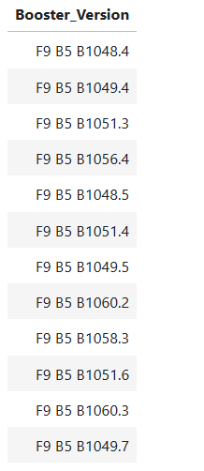
Boosters Carried Maximum Payload
%sql Select Booster_Version from SPACEXTBL where PAYLOAD_MASS__KG_ = ( select max(PAYLOAD_MASS__KG_) from SPACEXTBL)
The above list has all the boosters that have carried maximum payload. Subquery has been used to get the max payload

Slide 35
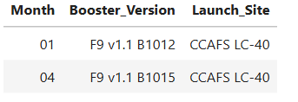
2015 Launch Records
%sql Select substr(Date, 6,2) as Month, Booster_Version, Launch_Site from SPACEXTBL where Landing_Outcome = 'Failure (drone ship)' and substr(Date,1,4)='2015’
There has been 2 failures in the year 2015 in the months of Jan and April. Where and substring has been used to filter the database

Slide 36
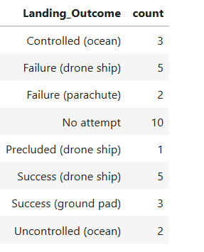
Rank Landing Outcomes Between 2010-06-04 and 2017-03-20
%sql SELECT Landing_Outcome, COUNT(Landing_Outcome) AS count FROM SPACEXTBL where Date between '2010-06-04' and '2017-03-20' GROUP BY Landing_Outcome;
The above list is the landing outcomes of all launches from 2010-06-04 to 2017-03-20. between used to filter the dates and they have been grouped by landing outcome

Slide 37

Section 3

Slide 38
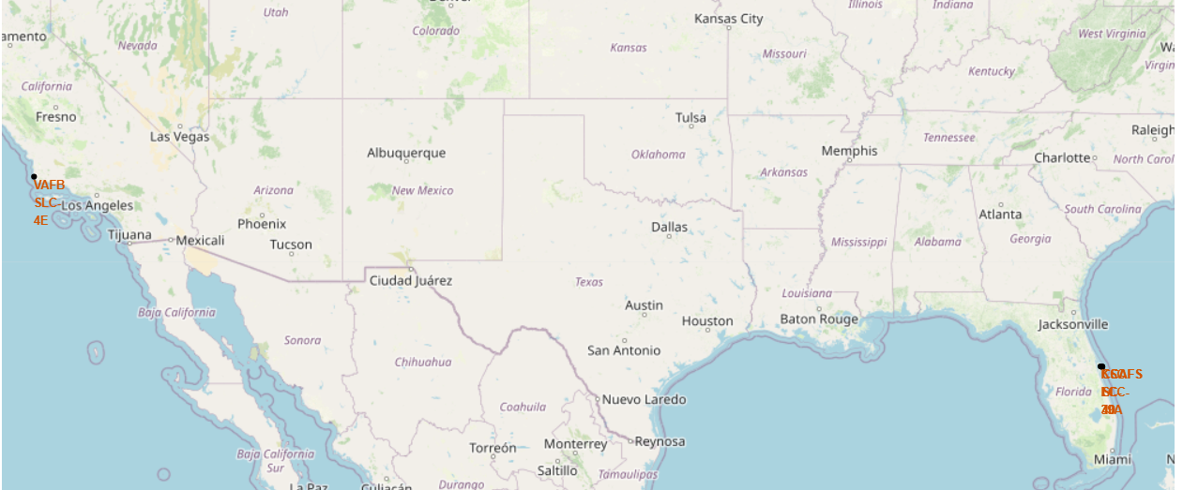
Location of Launch Sites
There are 4 launch sites used by SpaceX. 3 of them are located in the state of Florida and 1 is in California.

Slide 39
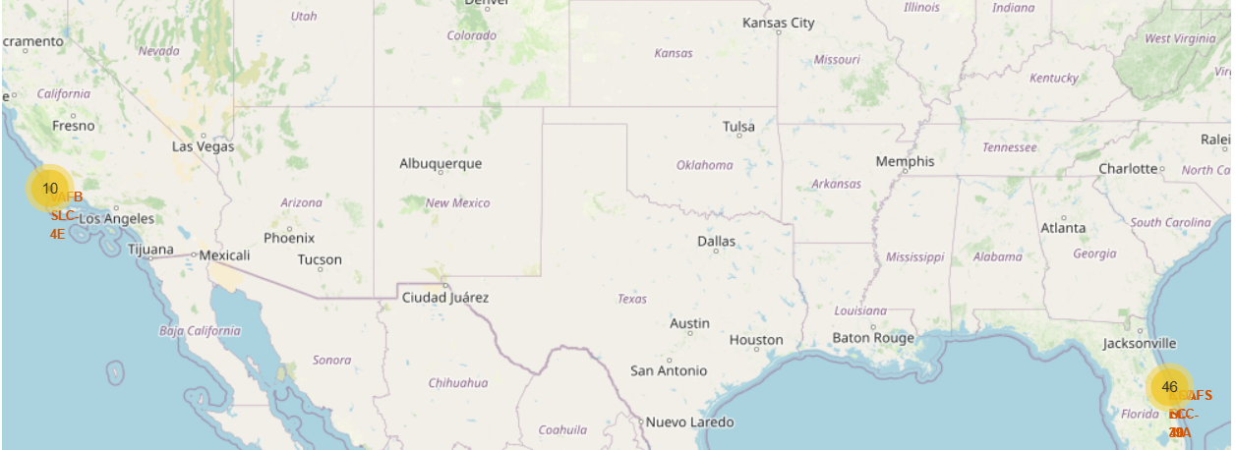
Success/ Failed Launches of each Site
The number of successful and unsuccessful launches of each site has been given using Marker Cluster

Slide 40
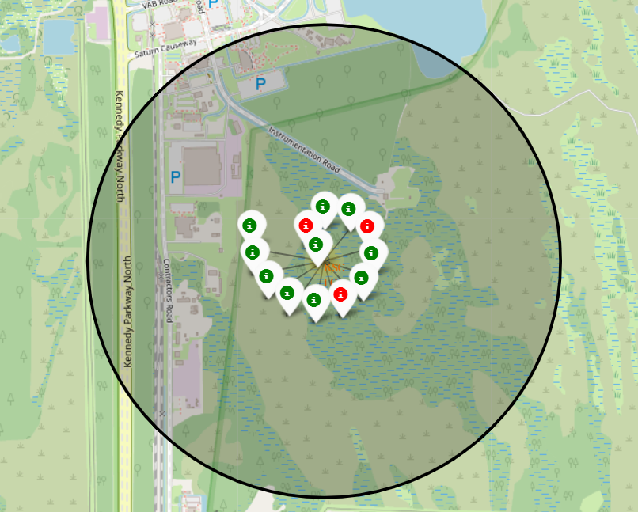
Success/ Failed Launches of each Site
This is the zoomed in image of the Cluster for the site KSC LC-39A.
The green and red icons show the number of successful and unsuccessful launches of SpaceX satellites in this particular launch site.

Slide 41
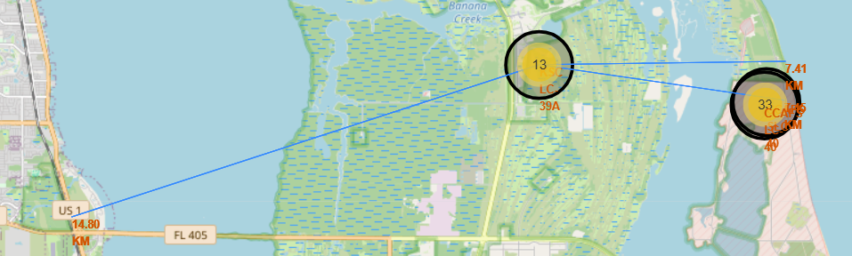
Proximity of Launch Site to other Locations
The launch site is close to the coastline. All 4 launch sites are close to the coastline.
They have highways and other roads pretty close to the launch site which helps in logistics
There are placed on the outskirts of a city. This launch site 15kms away from the nearest city

Slide 42

Section 4

Slide 43
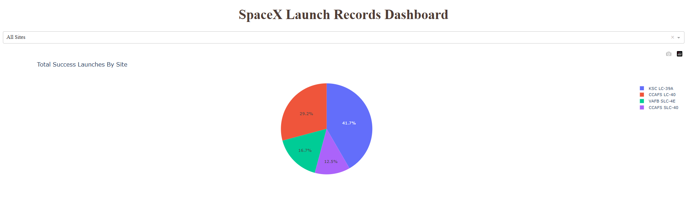
Total Success Launches by Site
The highest number of successful launches is from the site KSC LC -39A accounting for about 42% of total successful launches. The share of other sites has been visualized in the pie chart with the names given in the side.

Slide 44
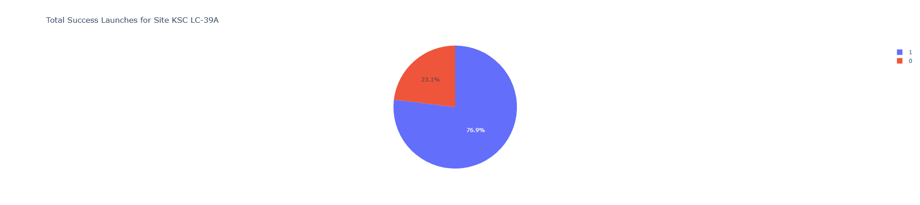
Site with the highest launch success ratio
KSC LC -39A site has the highest launch success ratio of 77% compared to all other sites. In the legend, 1 represents successful launches and 0 failures

Slide 45
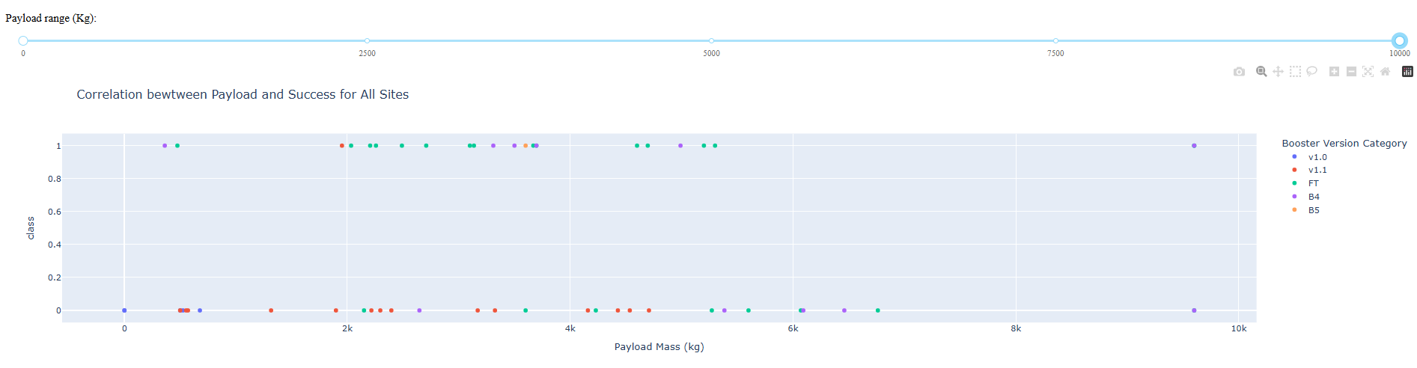
Payload vs Launch Outcome Scatter Plot
This is a scatter plot between payload mass and launch outcome. The points at the bottom(class 0) are failures and ones at the top(class 1) are successful launches.
The colors represent the booster version used for the rockets and we can see how different boosters are used for different mass and their success and failures

Slide 46

Section 5

Slide 47
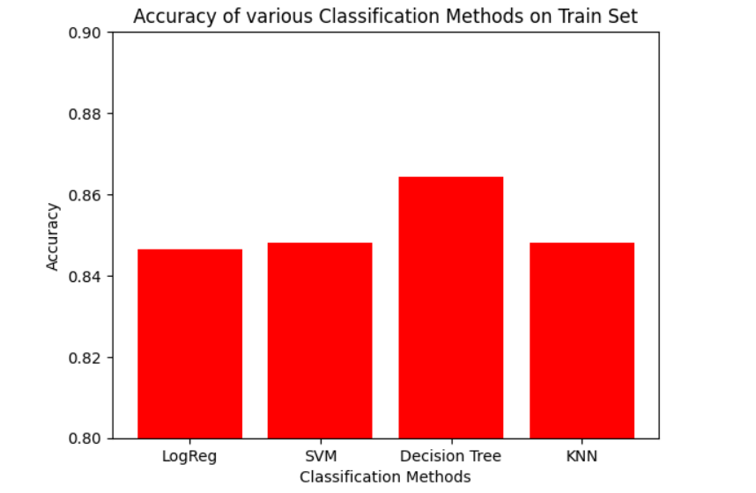
Classification Accuracy
The bar chart represents how accurately the models classify the training set
From the chart we can conclude that Decision Tree is the best method to use for this dataset.

Slide 48
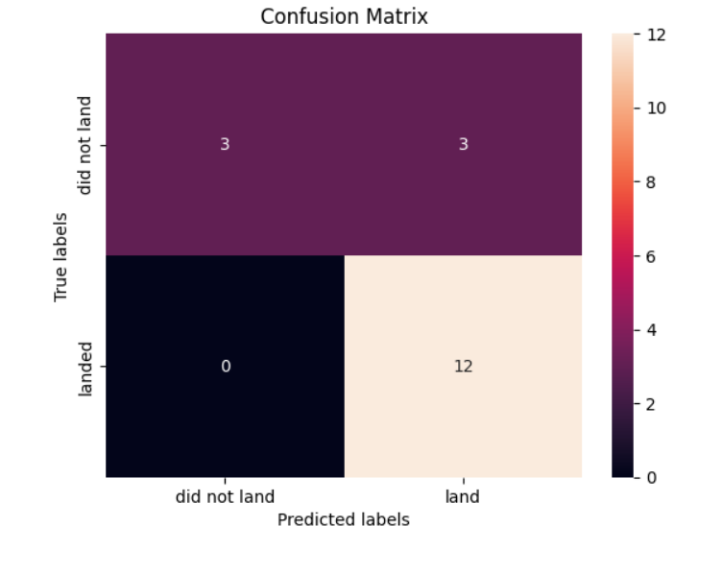
Confusion Matrix
This is the confusion matrix of the test set done using Decision Tree classification method
From the confusion matrix, we can see that there are 18 samples in the test set.
The model is accurately predicting when the satellite is successfully landing
The accuracy is less when it comes to unsuccessful landings where it classifies 3 unsuccessful landings as successful.

Slide 49
Conclusions
All launch vehicles have a specific payload that they can carry with VAFB SLC 4E site used for lower payloads
Success of a launch depends on the orbit where it is launched with orbits such as GEO, LEO, and SSO demonstrated higher success rates, whereas certain orbits like SO had no successful missions.
Heavy payloads the successful landing or positive landing rate are more for Polar, LEO and ISS. Payload greater than 10000kgs have been placed either in the ISS or VLEO orbit.

Slide 50
Conclusions
A clear upward trend in launch success rates was observed between 2010 and 2020, indicating improvements in SpaceX's technology and operational efficiency
Among the applied models, the Decision Tree method achieved the best training accuracy, offering reliable predictions for launch outcomes.
The test accuracy, precision and recall are 83.3%, 80% and 100%.

Slide 51
Appendix
The link to the SpaceX API can be accessed Here.
The link to the Falcon9 Launch Vehicle Data used for web scraping is provided Here.
All code snippets are available on GitHub via the following link Here.

Slide 52


